Slide 1


Presentation: Coworking Square Room Booking Service
This structure covers the entire UX/UI process for creating the room booking service at Coworking Square, ensuring a user-centered design that addresses the needs and preferences of different user types.

Slide 2

click there to open feedback form
https://o6tzp7qluwr.typeform.com/to/yMvX17Wl

Slide 3
Introduction of Concepts
Booking Calendar:
Interactive, easy-to-use interface for booking spots.
Payment Gateway: Secure, integrated payment system for upfront payments.
User Profiles: Personal accounts to manage bookings and payments.
Notifications: Email and SMS reminders for upcoming bookings.
Project Planning
Timeline: 12 weeks
Tools Chosen:
Wireframing: Figma
Prototyping: Figma, InVision
User Research: Google Forms, Zoom
User Testing: UserTesting.com
Initial Brief
Client: Barbara, Coworking Square, Amsterdam
Objective: Develop an online room booking service allowing clients to book weekly, monthly, or daily spots and pay upfront.
Current Challenge: Inefficient paper calendar system for booking and billing.
User Research Findings
Methods:
Qualitative: Interviews with Barbara and 5 existing clients
Quantitative: Surveys sent to 50 clients
Personas:
Fiona - Steve - Rachel - Carl –
Figures:
60% of users prefer online booking.
75% want upfront payment options.
50% find the current system inefficient.
Mid-Fidelity PrototypeDemo
Tool: Figma/InVision
Demo: Include showing presentation with the mid-fidelity prototype covering the 4 user journeys
Usability Testing Feedback
Method: 5 tests per persona
KeyFindings:
Fiona: Appreciated the quick booking process but requested more information on available amenities
Steve: Found team booking feature useful but wanted more detailed invoices.
Rachel: Liked the quiet space guarantee but suggested adding reviews of spots.
Carl: Enjoyed the upfront payment but desired more payment options.
Problem Statements
Fiona:
Needs a quick and easy way to book hot spots daily without hassle.
Steve:
Requires a streamlined process for booking multiple spots for his team monthly.
Rachel:
Wants a reliable way to book weekly with assurance of a quiet workspace.
Carl:
Prefers an intuitive booking system with upfront payment to avoid billing issues.
UX
phases

Slide 4
Initial Brief
Client: Barbara, Coworking Square, Amsterdam
Objective: Develop an online room booking service allowing clients to book weekly, monthly, or daily spots and pay upfront.
Current Challenge: Inefficient paper calendar system for booking and billing.
Project Planning
Timeline: 12 weeks
Tools Chosen:
Wireframing: Figma
Prototyping: Figma, InVision
User Research: Google Forms, Zoom
User Testing: UserTesting.com
User Research Findings
Methods:
Qualitative: Interviews with Barbara and 5 existing clients
Quantitative: Surveys sent to 50 clients
Personas:
Fiona - Steve - Rachel - Carl –
Figures:
60% of users prefer online booking.
75% want upfront payment options.
50% find the current system inefficient.
Problem Statements
Fiona:
Needs a quick and easy way to book hot spots daily without hassle.
Steve:
Requires a streamlined process for booking multiple spots for his team monthly.
Rachel:
Wants a reliable way to book weekly with assurance of a quiet workspace.
Carl:
Prefers an intuitive booking system with upfront payment to avoid billing issues.
Introduction of Concepts
Booking Calendar:
Interactive, easy-to-use interface for booking spots.
Payment Gateway: Secure, integrated payment system for upfront payments.
User Profiles: Personal accounts to manage bookings and payments.
Notifications: Email and SMS reminders for upcoming bookings.
Mid-Fidelity PrototypeDemo
Tool: Figma
Demo: Include showing presentation with the mid-fidelity prototype covering the 4 user journeys
Usability Testing Feedback
Method: 5 tests per persona
KeyFindings:
Fiona: Appreciated the quick booking process but requested more information on available amenities
Steve: Found team booking feature useful but wanted more detailed invoices.
Rachel: Liked the quiet space guarantee but suggested adding reviews of spots.
Carl: Enjoyed the upfront payment but desired more payment options.
UX
phases

Slide 5

Identifying Needs: Steve needs to book multiple spots monthly for his team.
Platform Exploration:
He discovers a platform offering team booking features.
Booking Process: Steve sets up his team profile, selects locations, and ensures amenities like meeting rooms are available.
Invoice Requirements: Desires more detailed invoices.
Steve
Feedback and Repeat Use: Leaves feedback on amenity information and continues using if needs are met.
Steve
32 years old
startuper

Slide 6

Identifying Needs: Fiona seeks a quick and easy way to book hot spots daily.
Platform Exploration: Finds a platform with a quick booking process.
Booking Process: Searches, filters by amenities like reliable Wi-Fi, and books a spot.
Amenities Information: Requests more detailed amenity information.
Fiona
25 years old,
freelancer

Slide 7

Identifying Needs: Rachel needs a reliable way to book weekly for a quiet workspace.
Platform Exploration: Searches for platforms offering quiet space guarantees.
Booking Process: Selects quiet workspace options, checks availability, and books weekly.
Rachel
Reviews of Spots: Suggests adding spot reviews for better decision-making.
Feedback and Repeat Use: Provides feedback on spot reviews and continues using if satisfied.
28 years old,
Remote
worker

Slide 8

Identifying Needs: Carl prefers an intuitive booking system with upfront payment.
Platform Exploration: Finds a platform offering upfront payment options.
Booking Process: Navigates an intuitive booking system, pays upfront.
Payment Options: Desires more payment options beyond upfront payment.
Feedback: Provides feedback on payment options and continues using if expanded.
Carl
48 years old,
consultant

Slide 9

2
Moodboard
1
Project Planning
UI
6 Programming
phases
3
Styleguide
4 Prototype
5 Testing

Slide 10

Moodboard

Slide 11
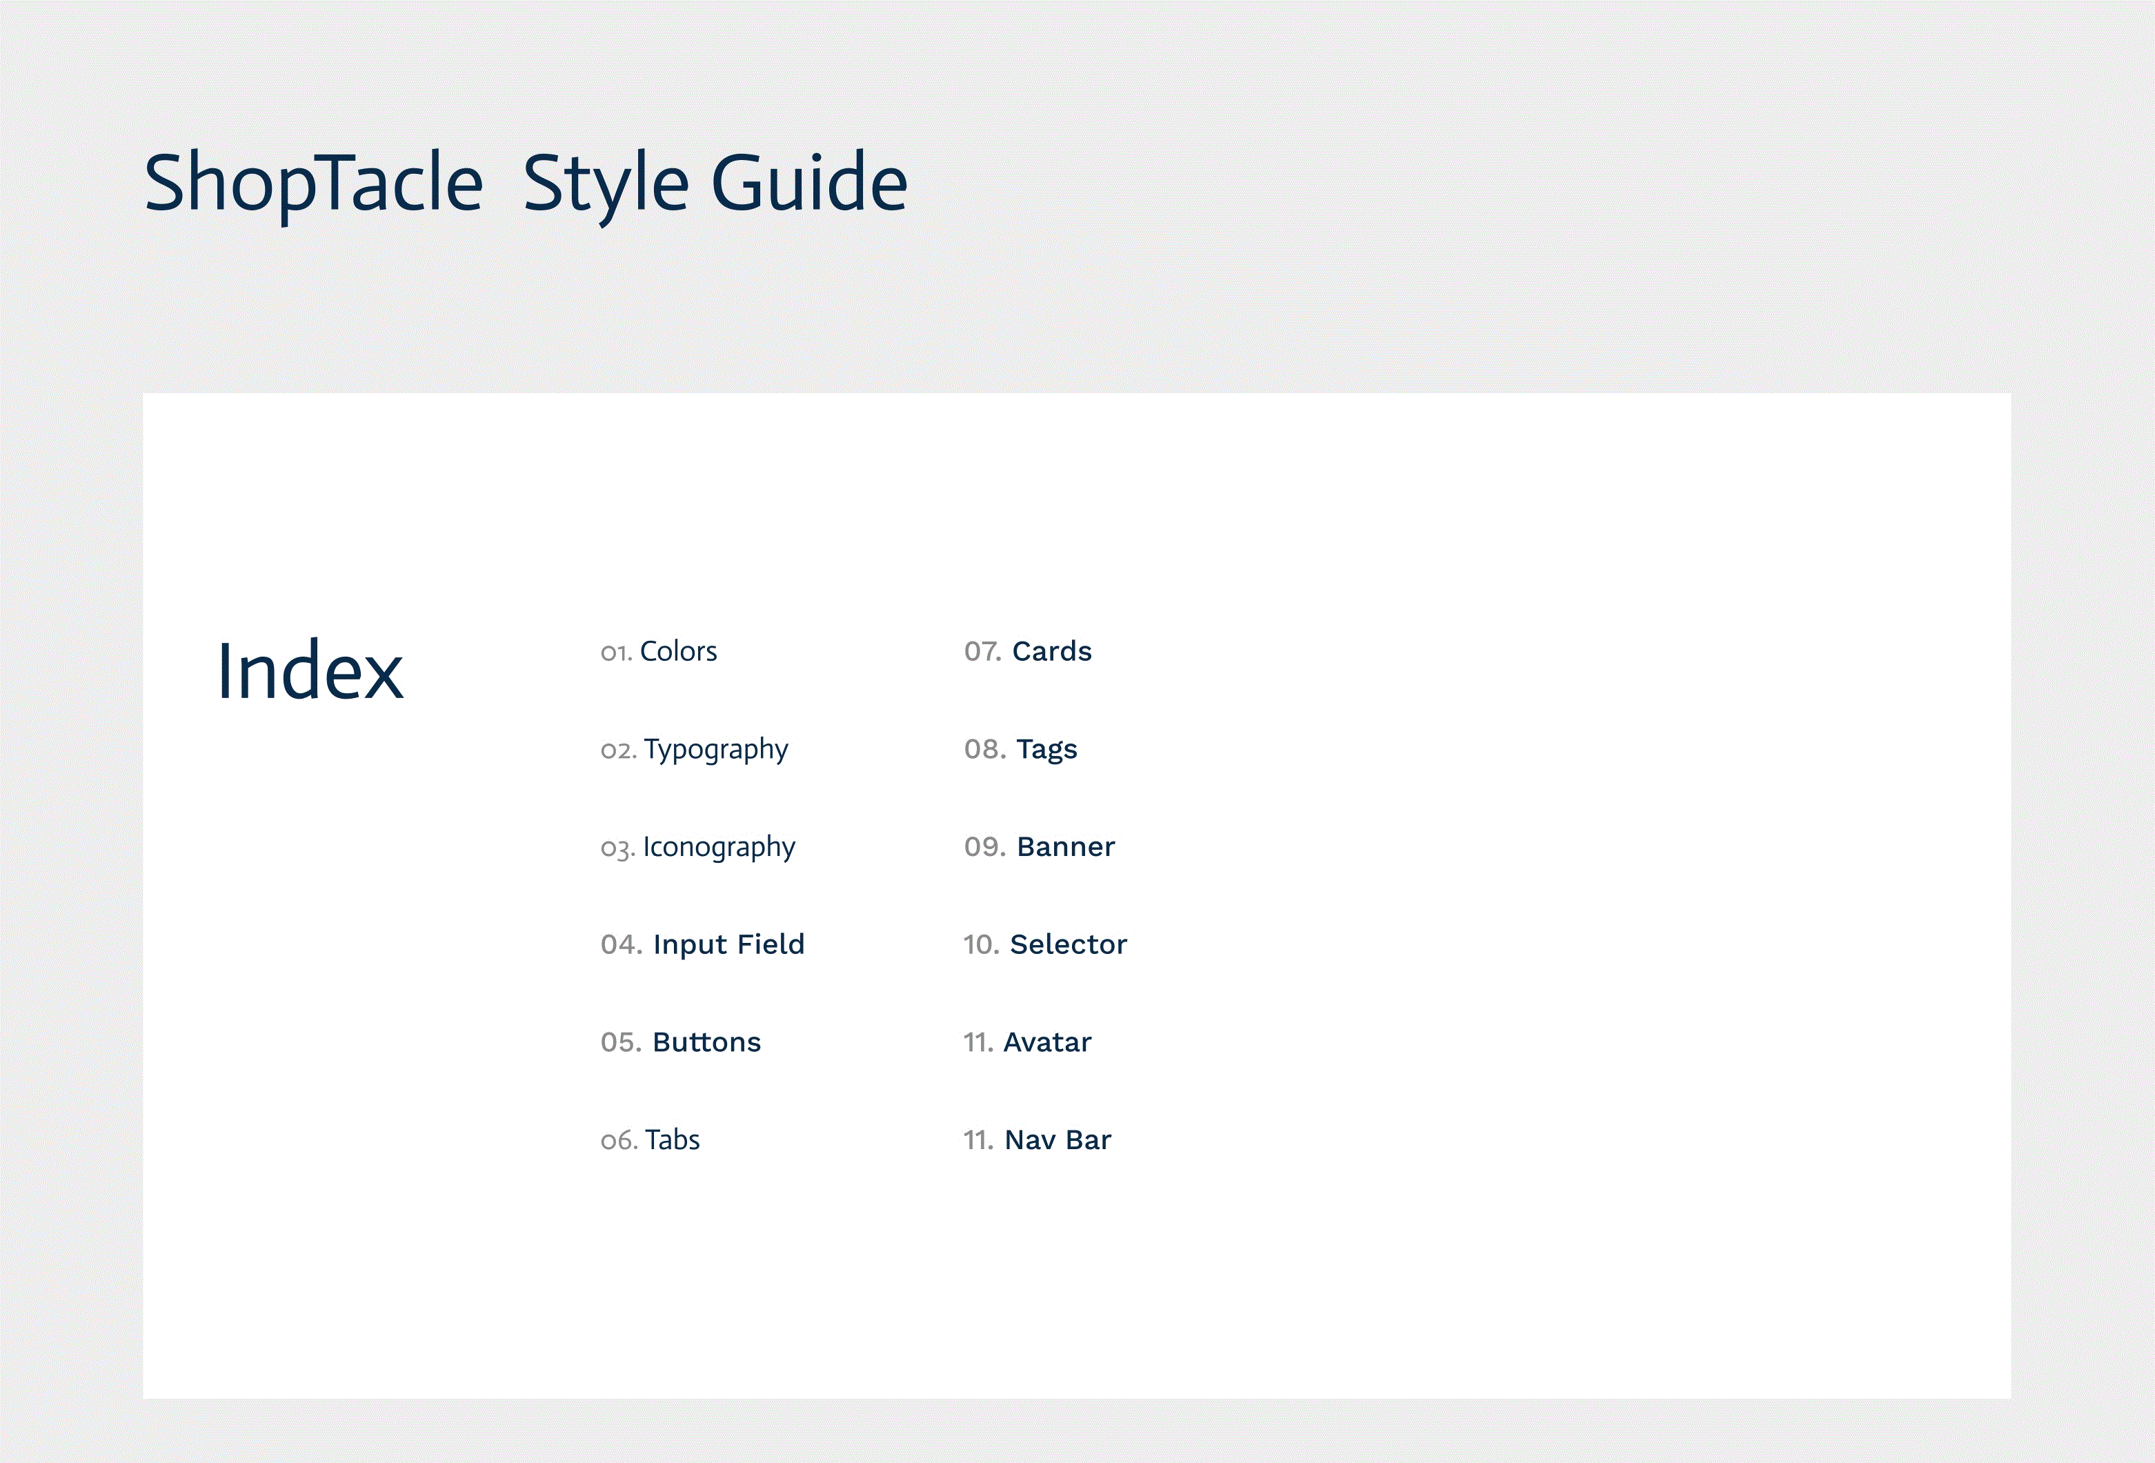

Slide 12
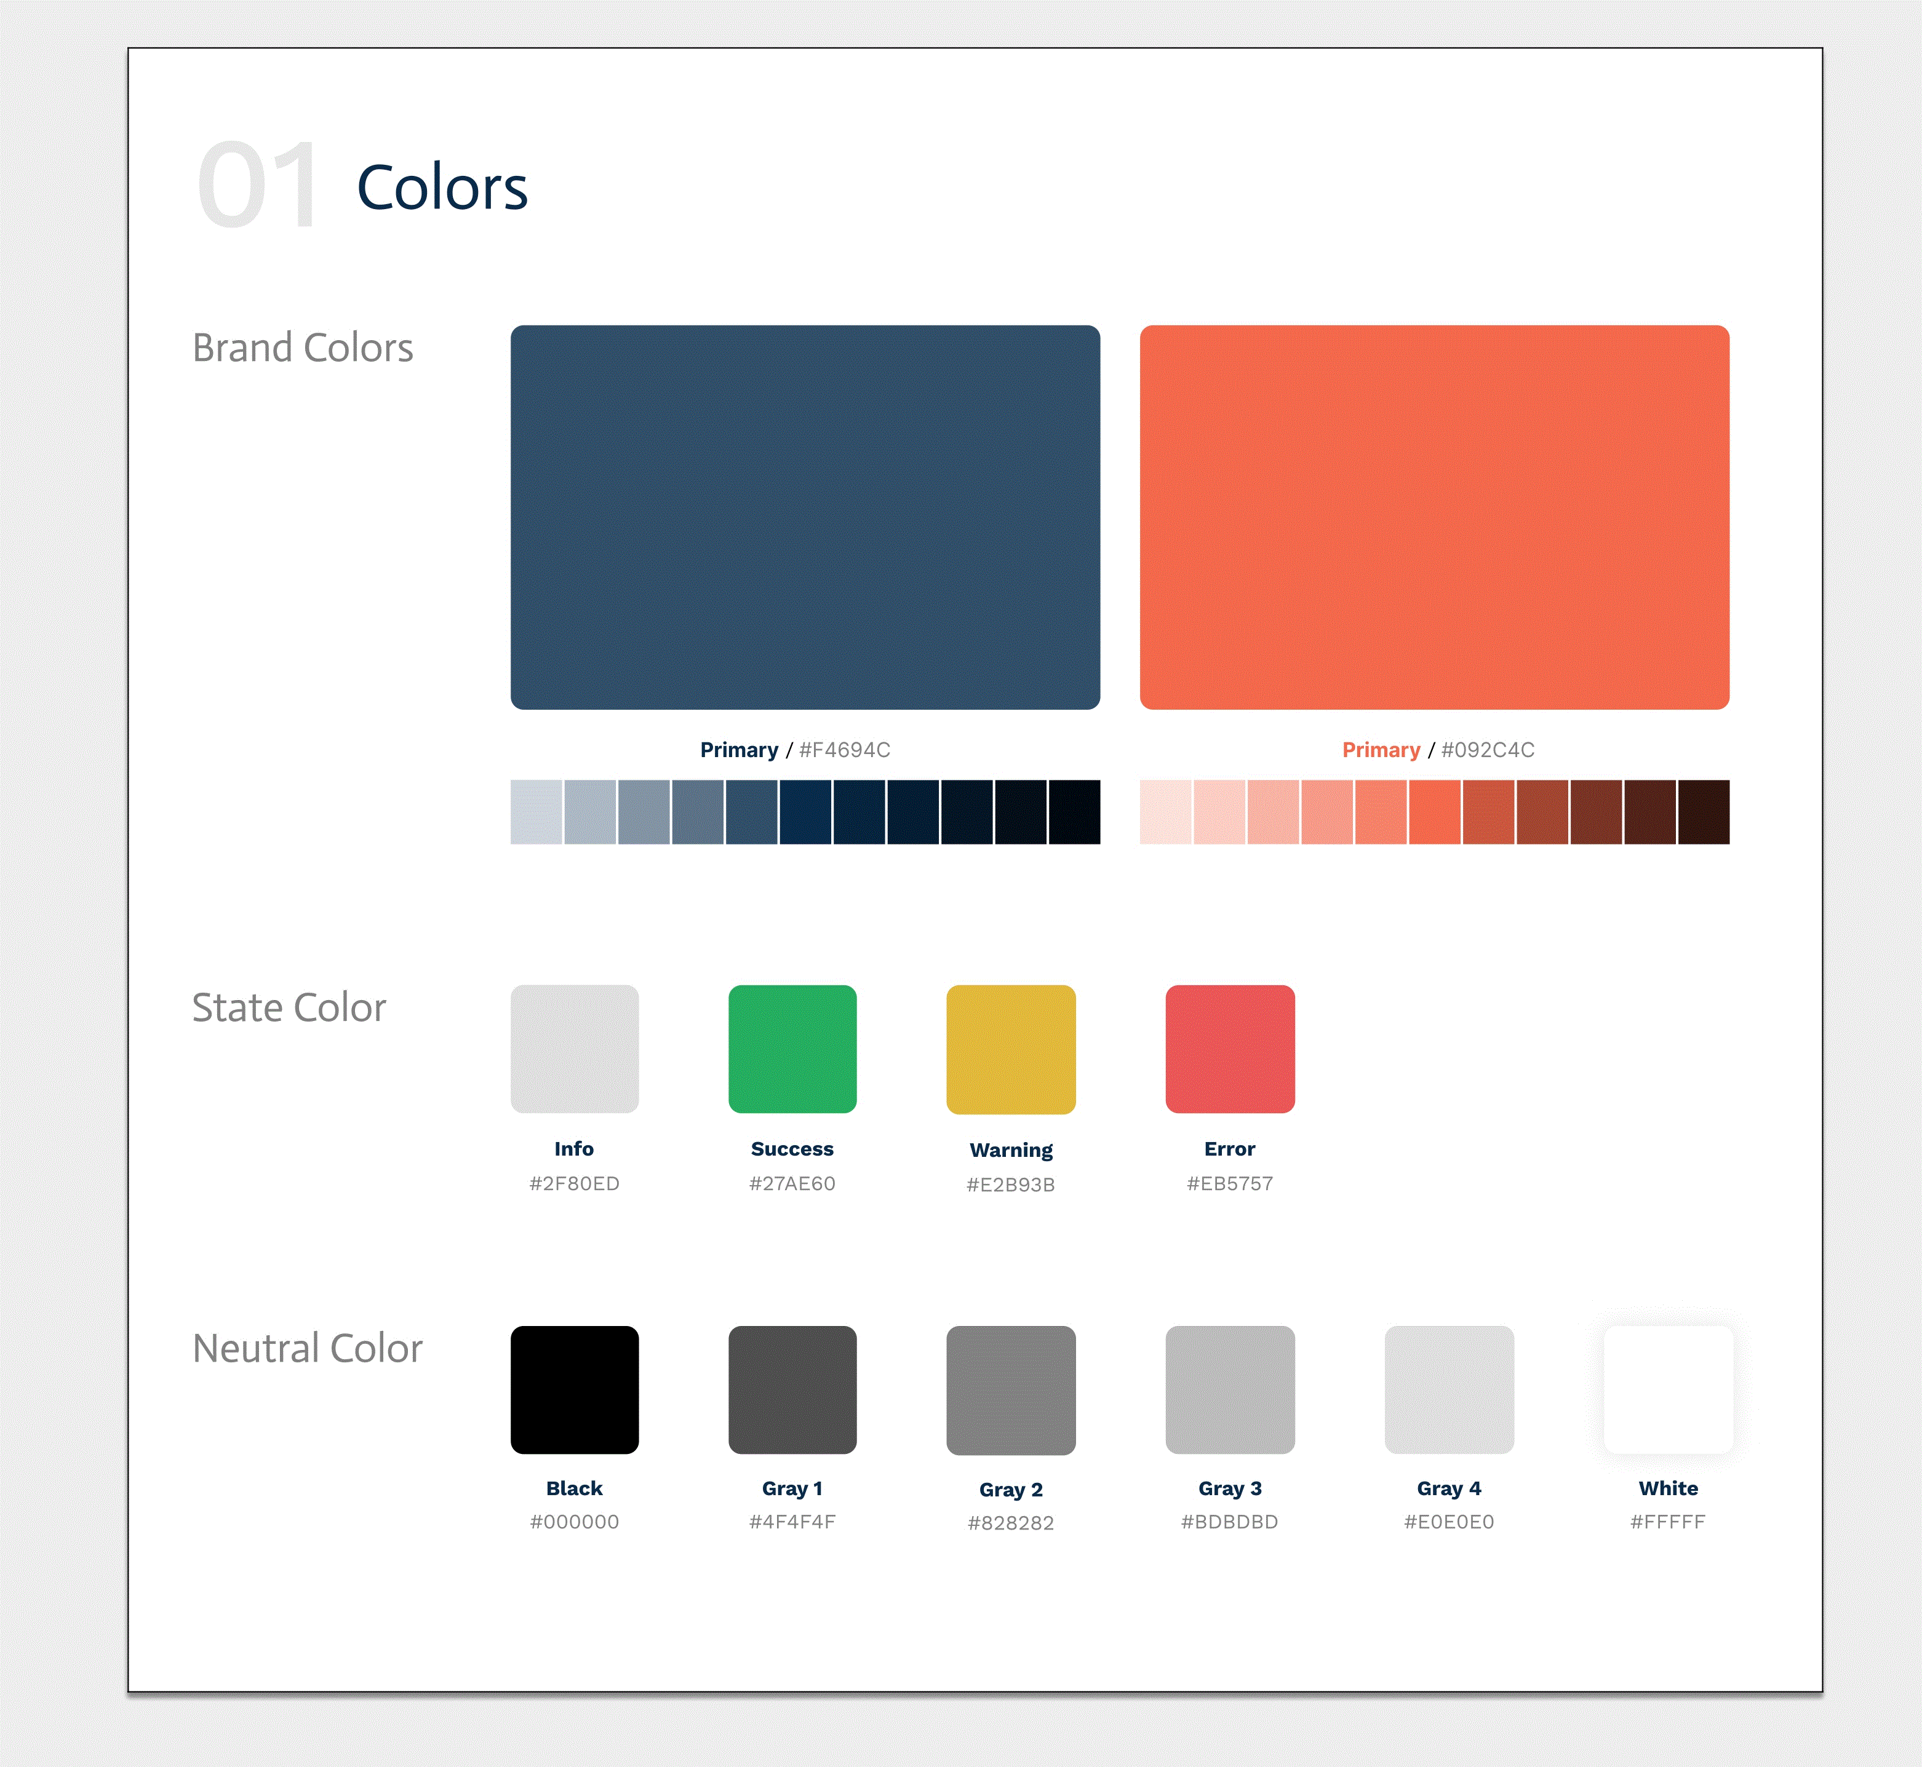

Slide 13
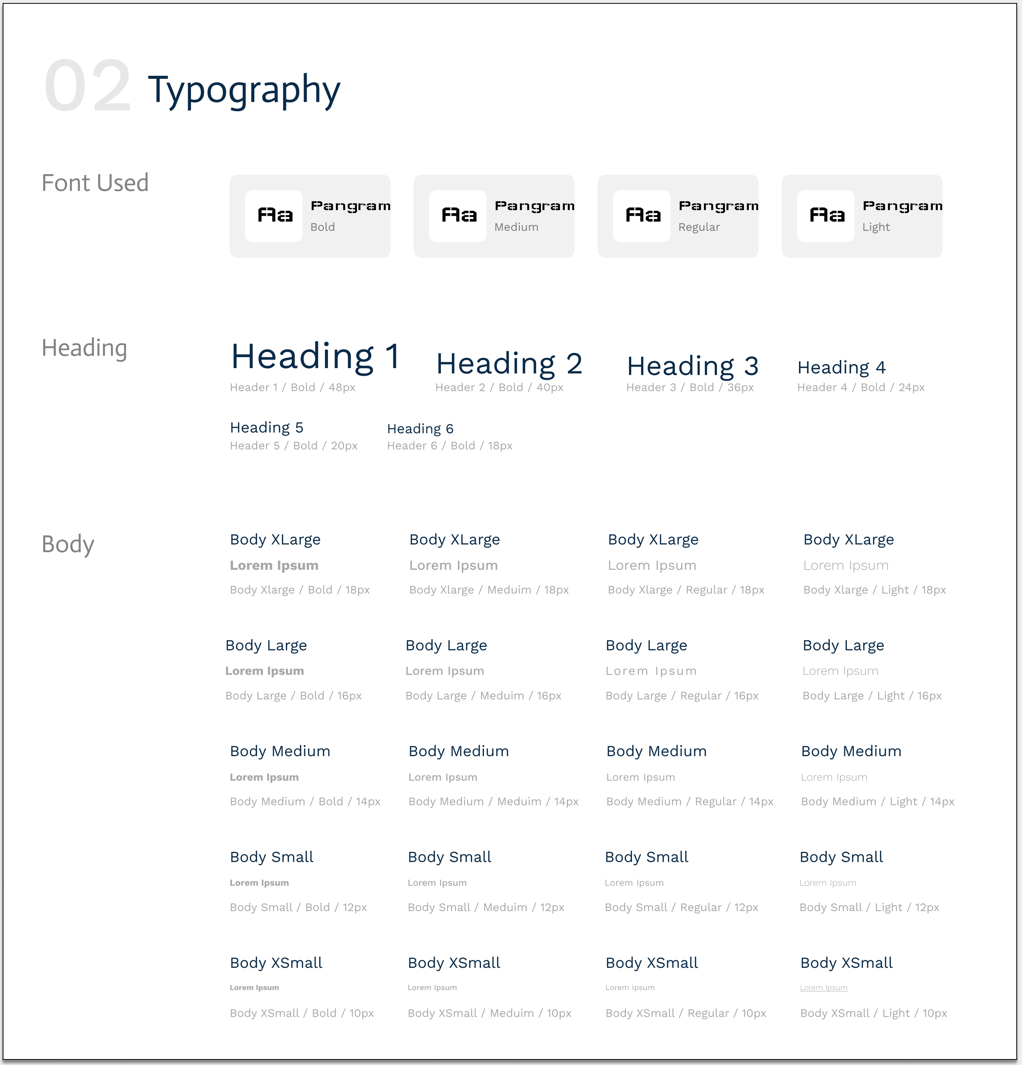

Slide 14
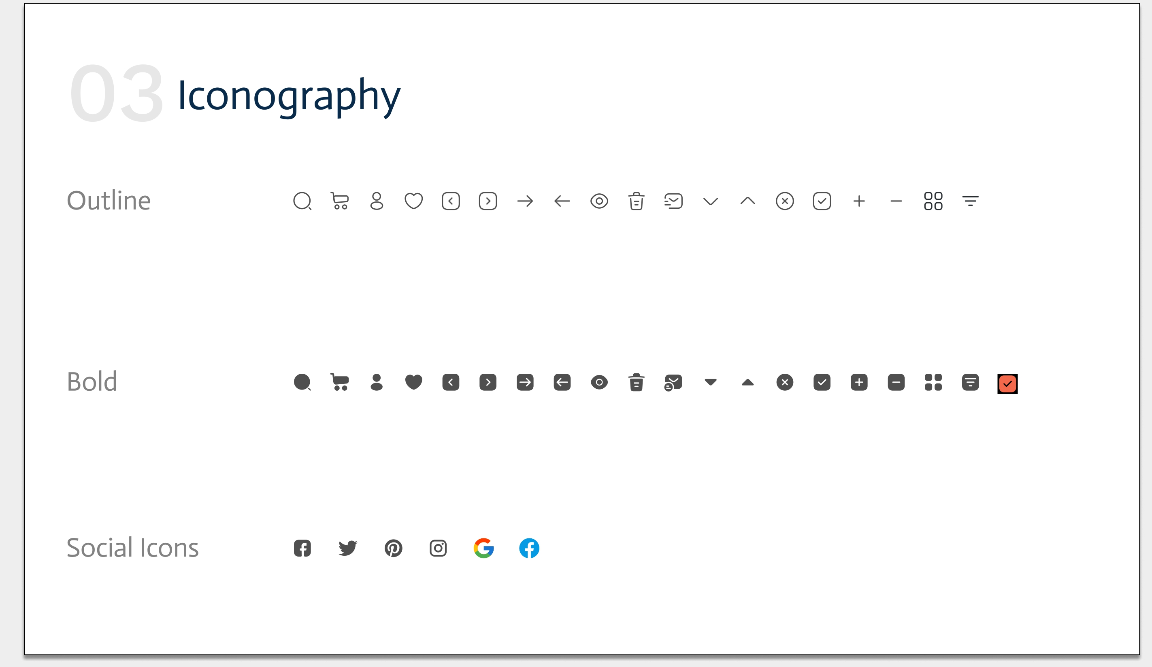

Slide 15
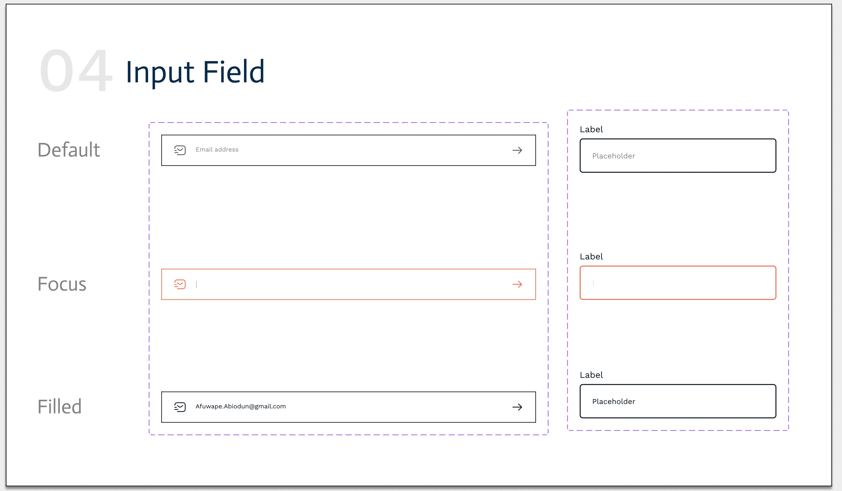

Slide 16
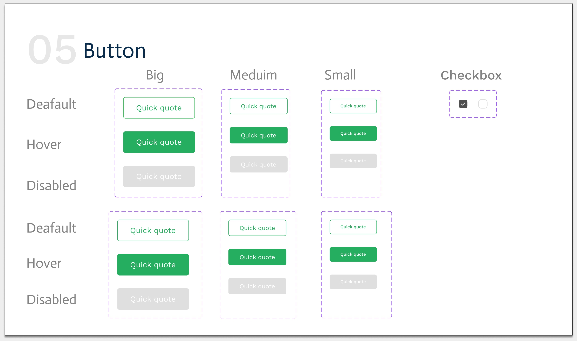

Slide 17
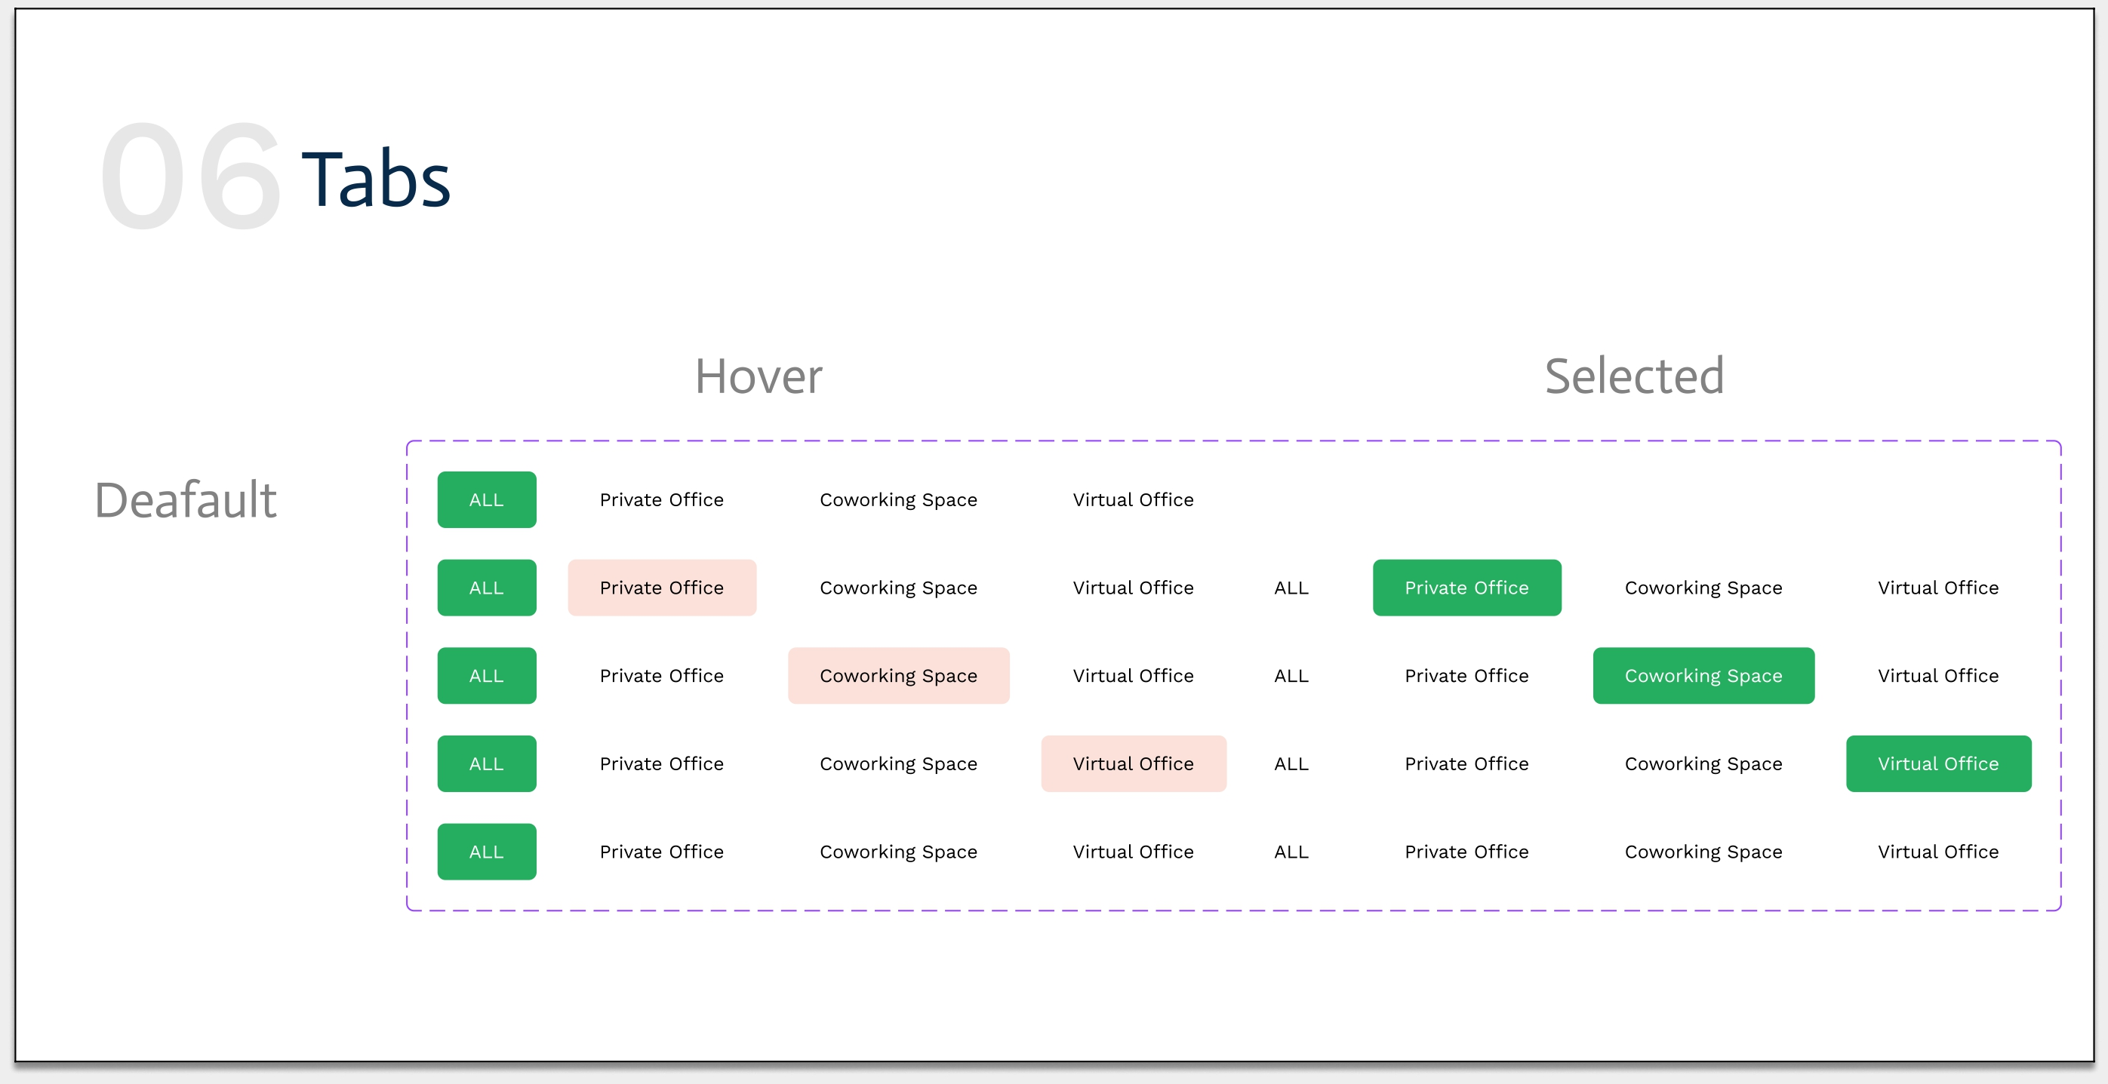

Slide 18
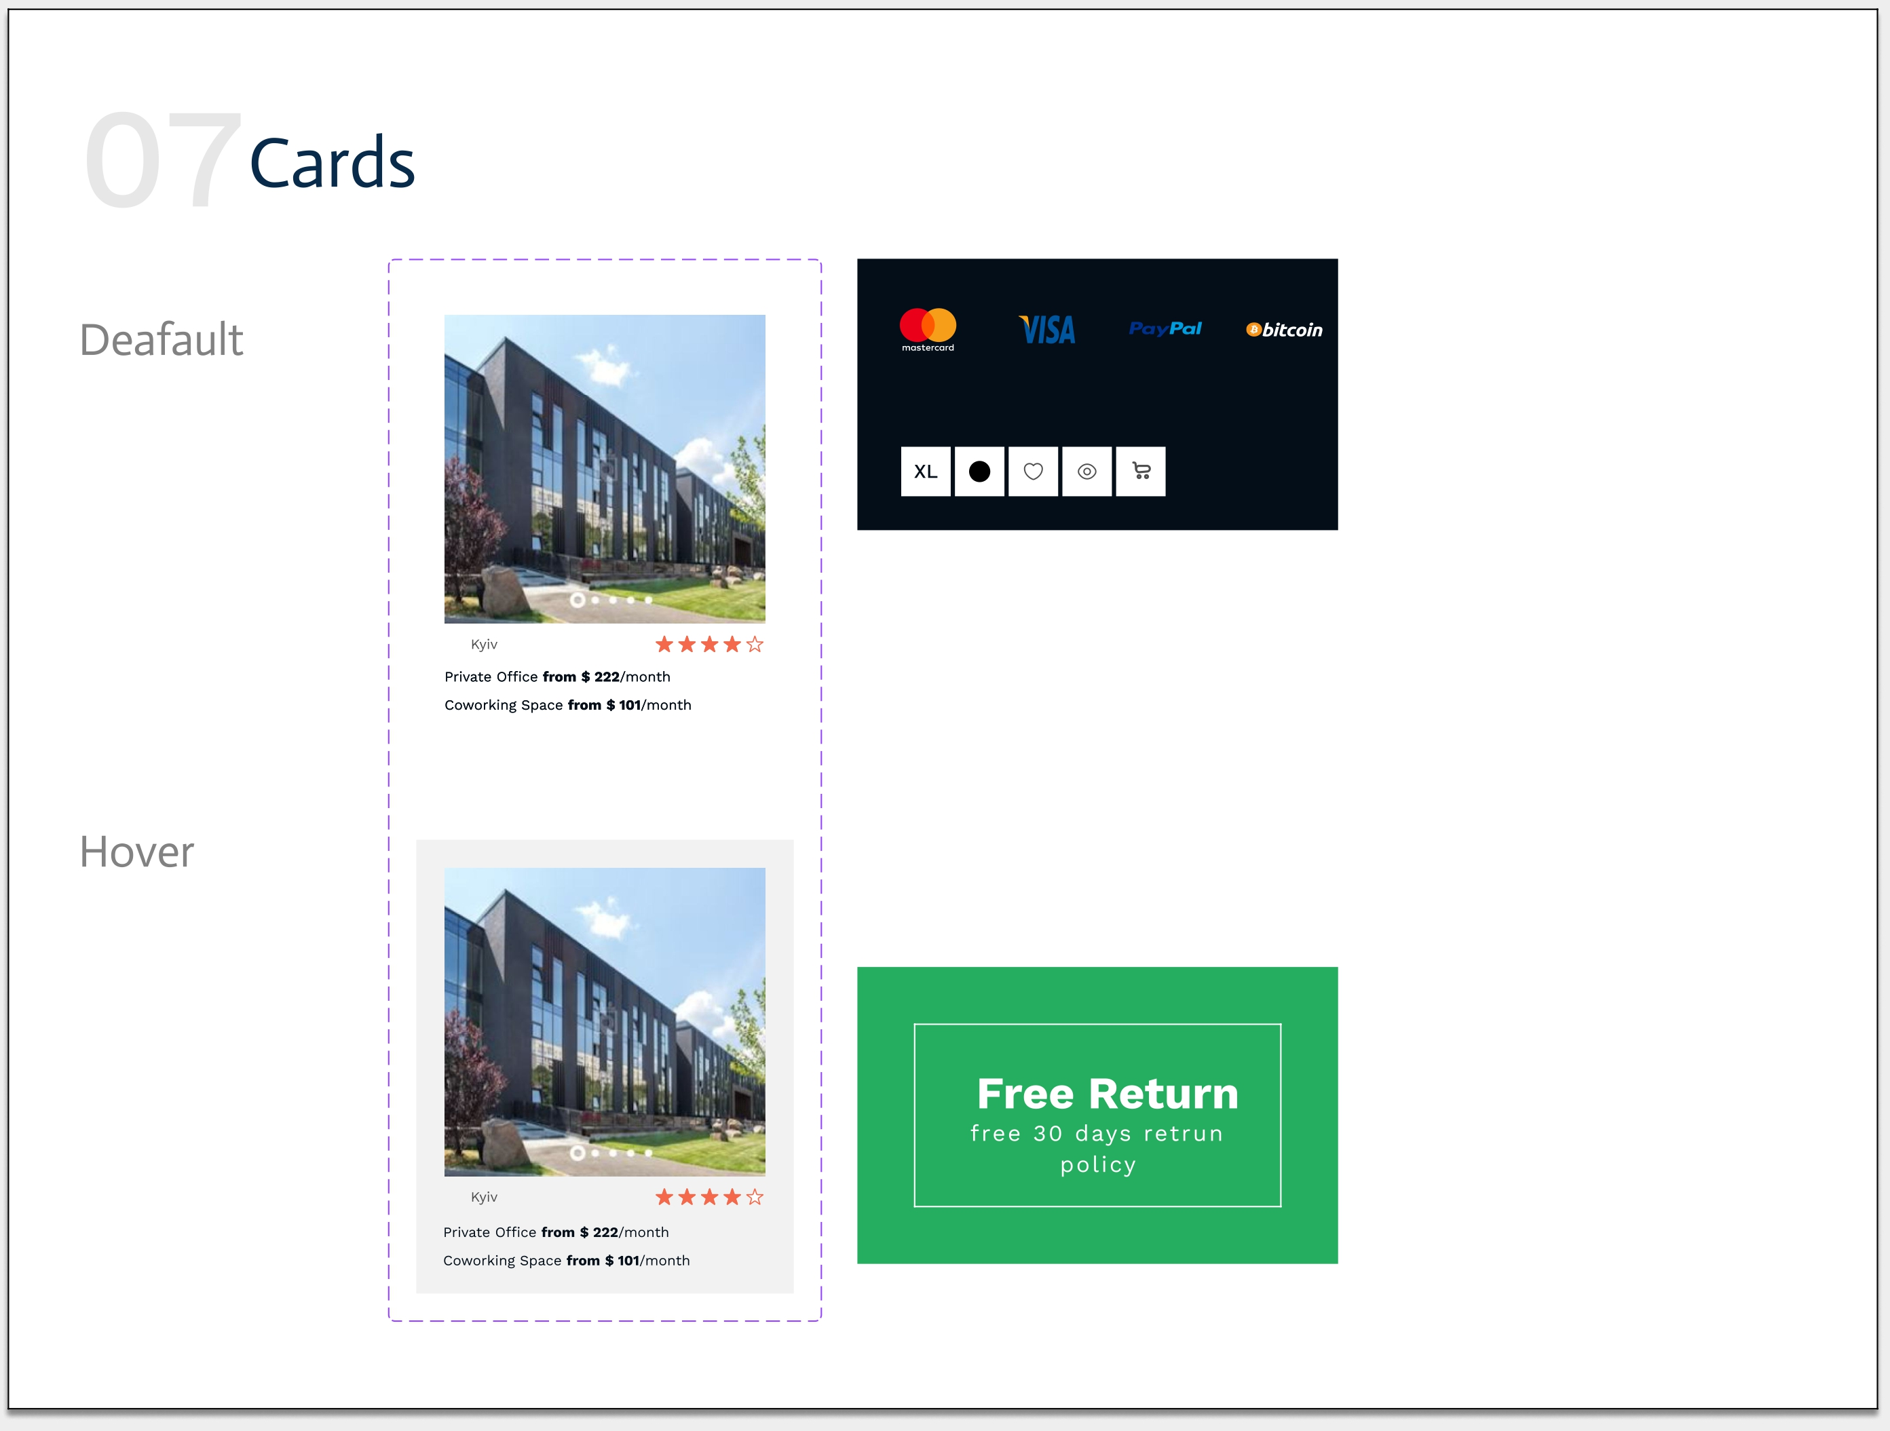

Slide 19
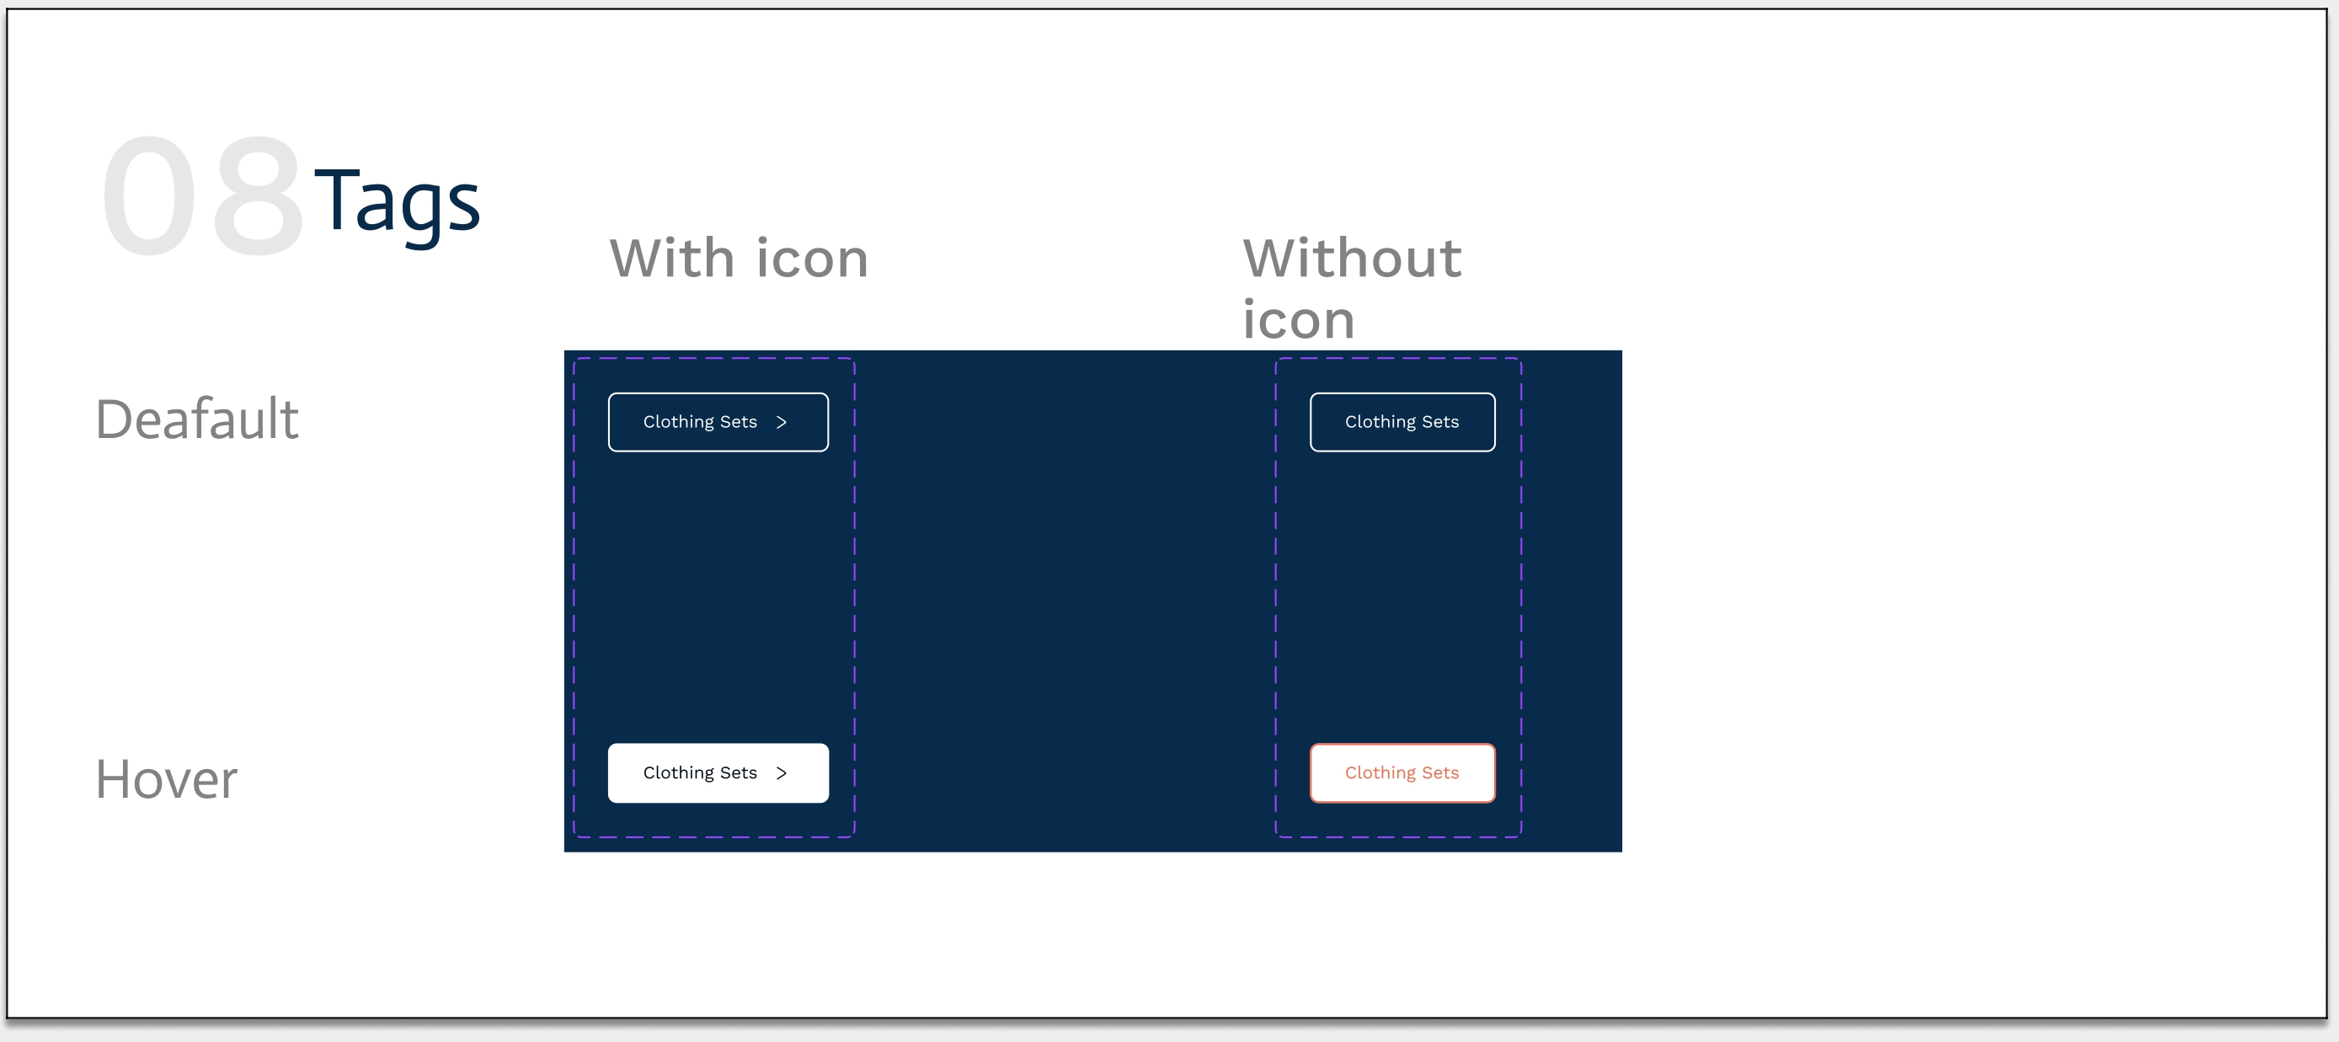

Slide 20
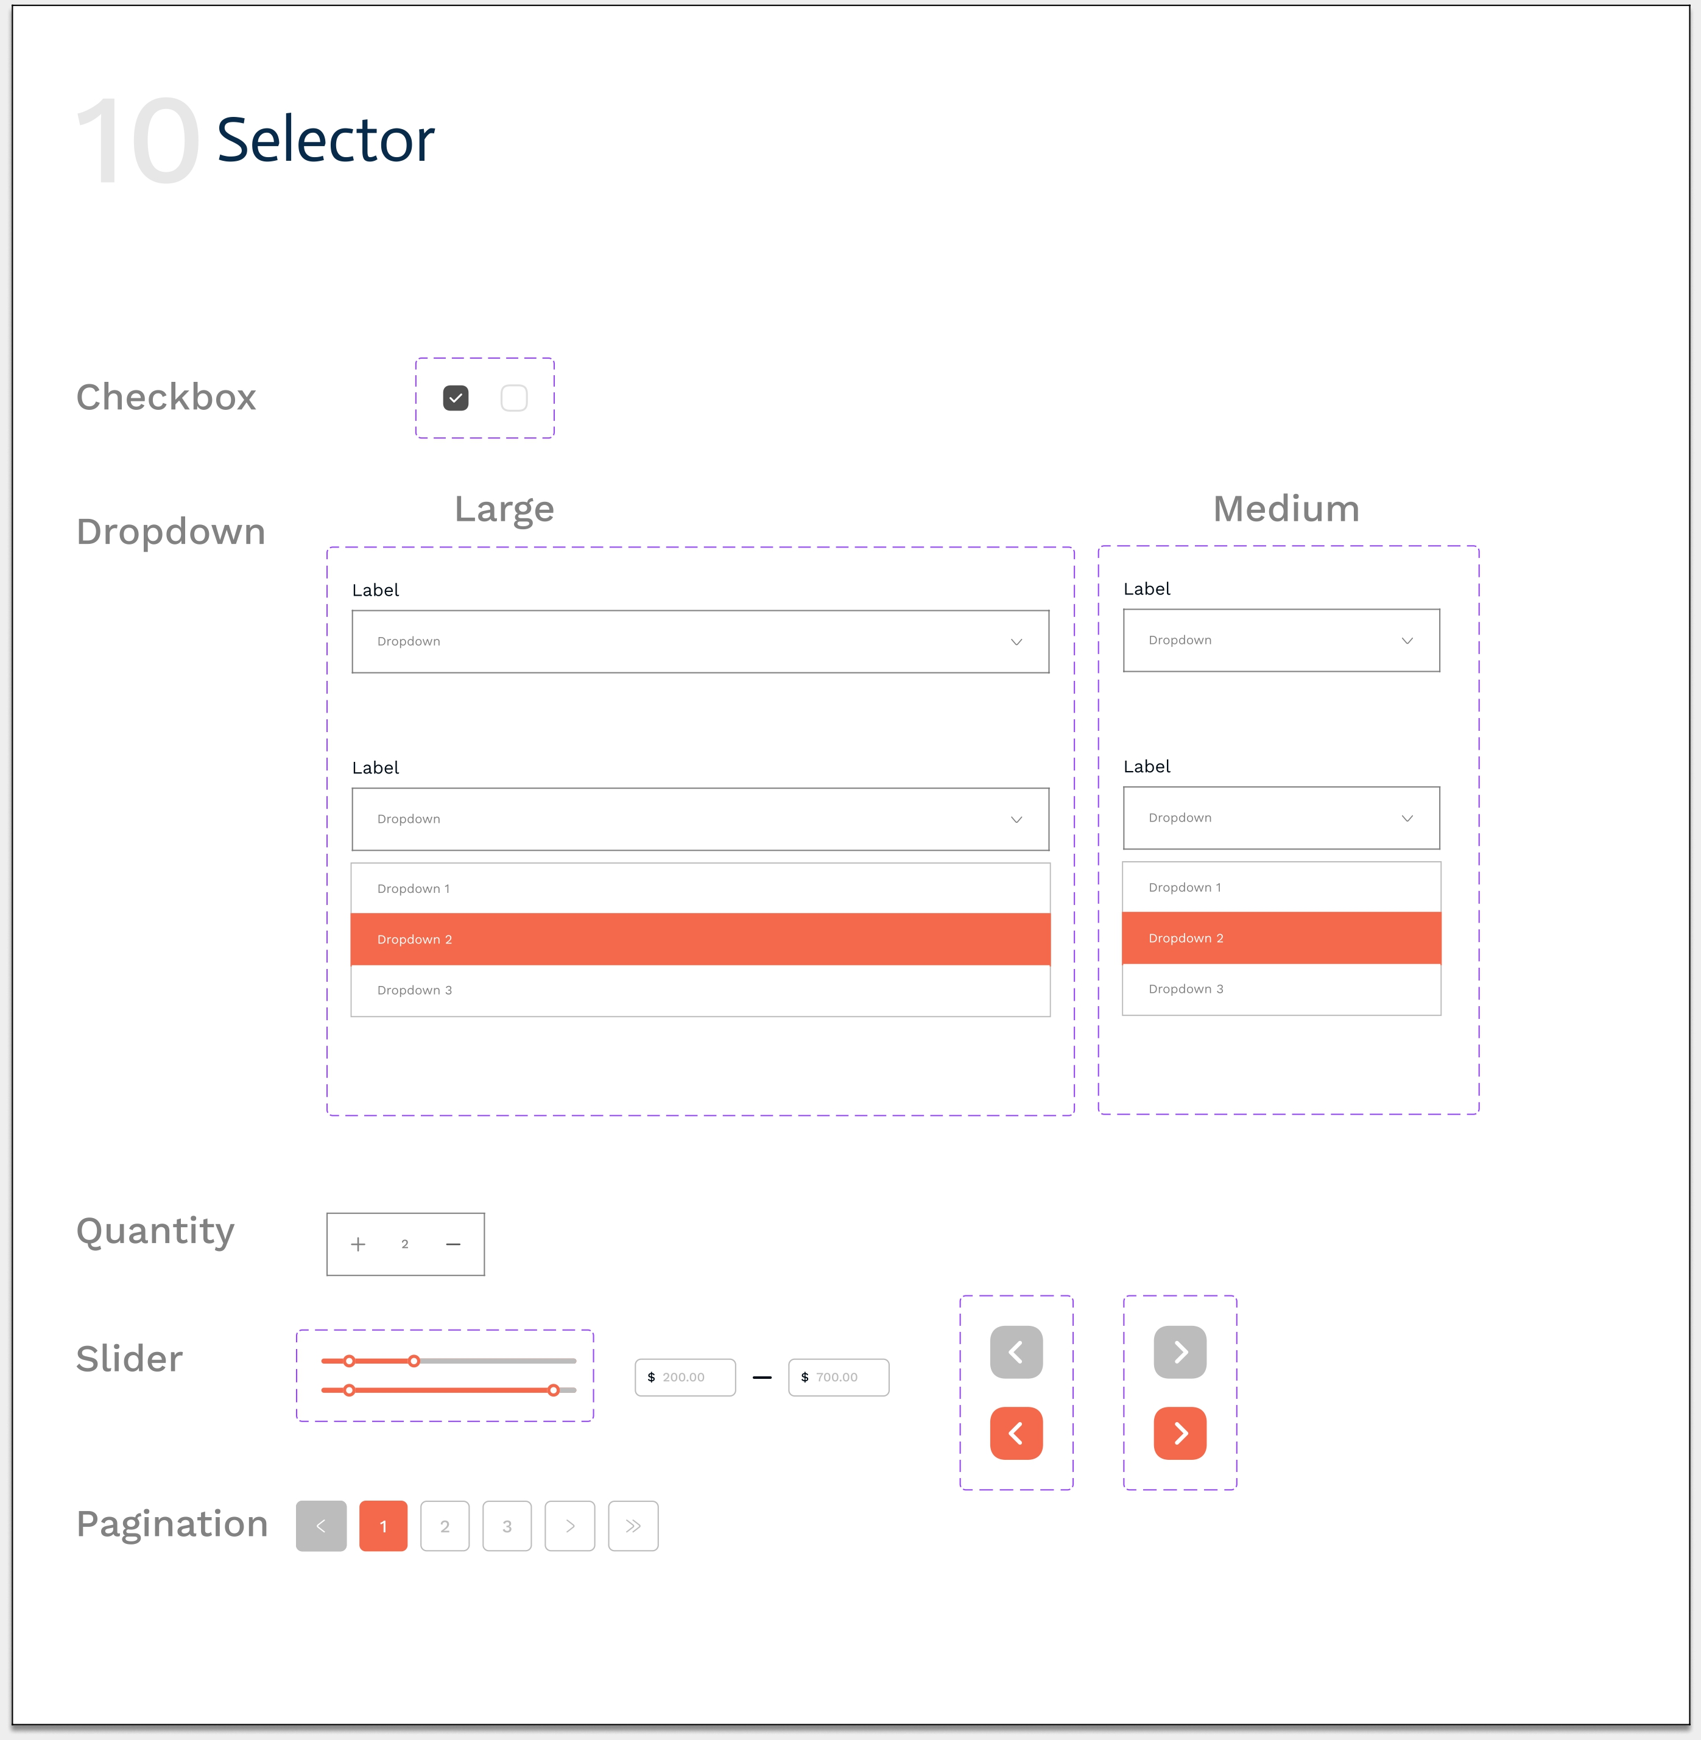

Slide 21
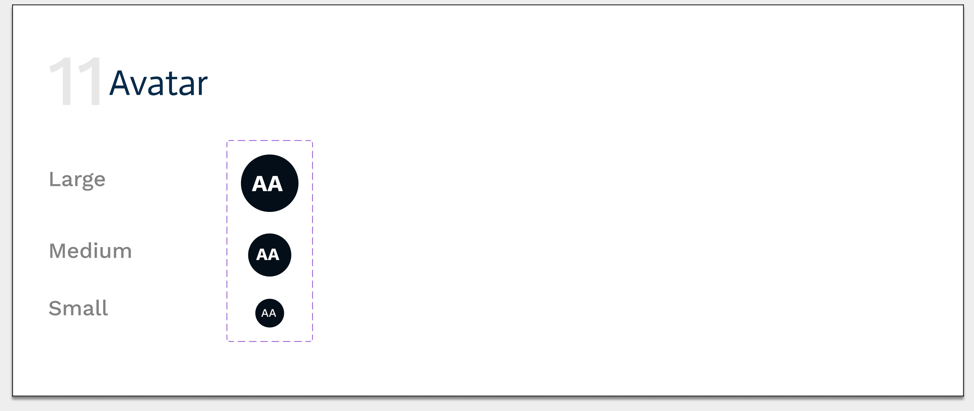

Slide 22
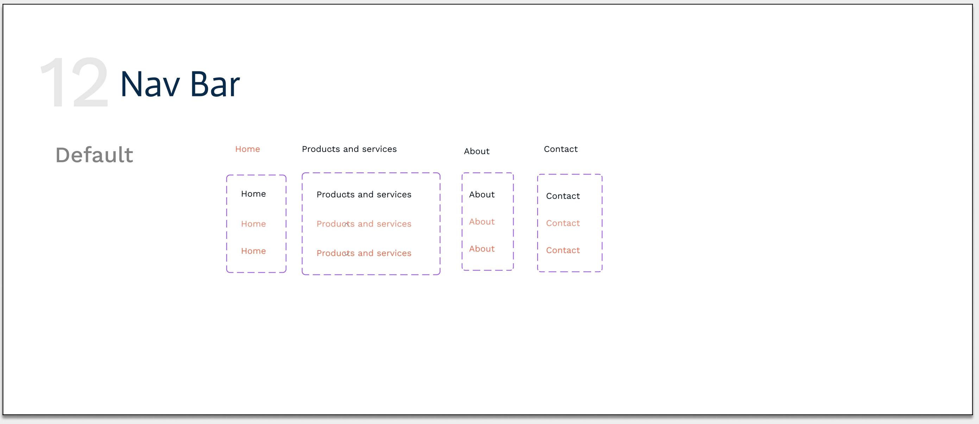

Slide 23
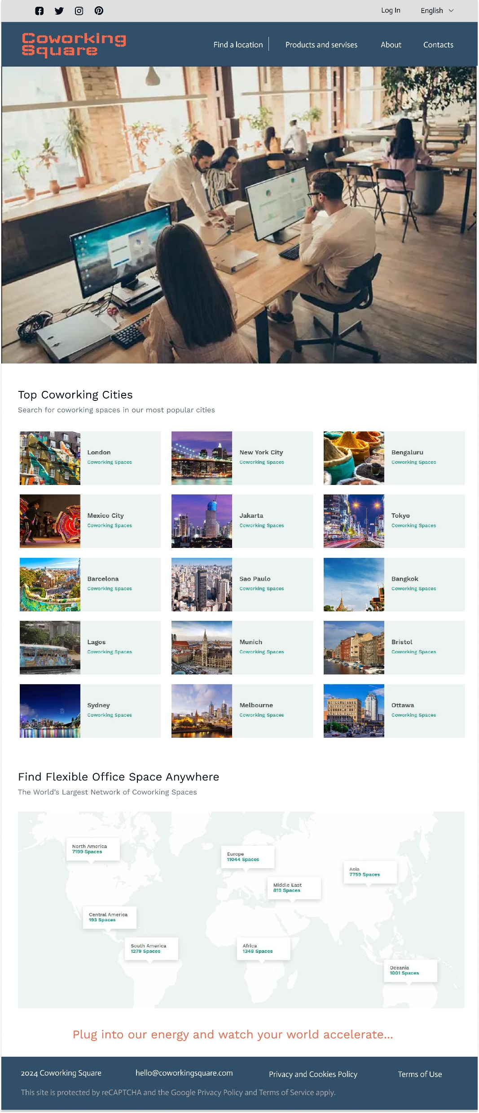
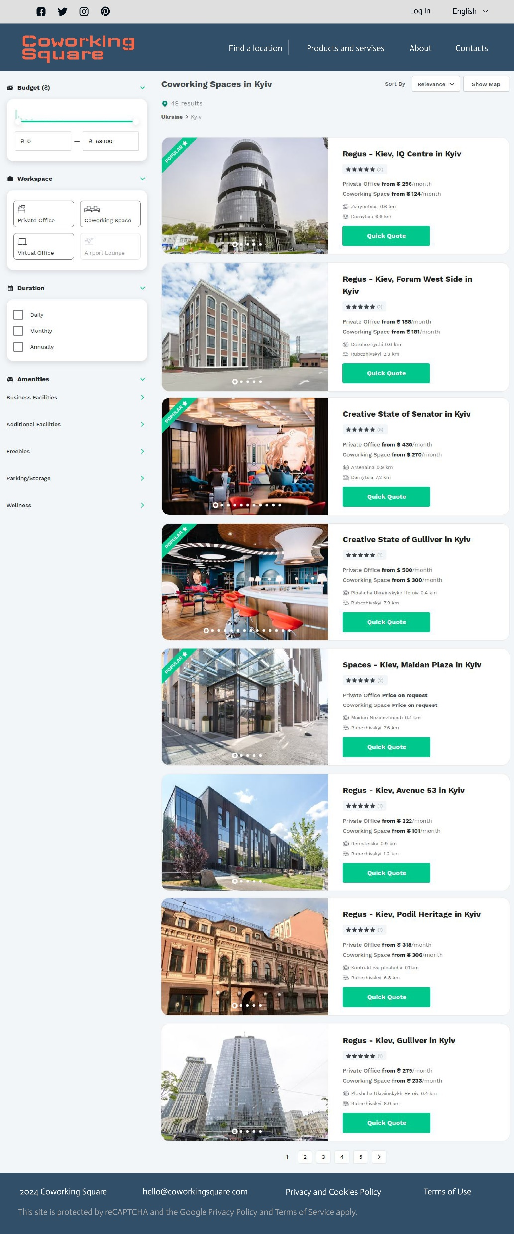
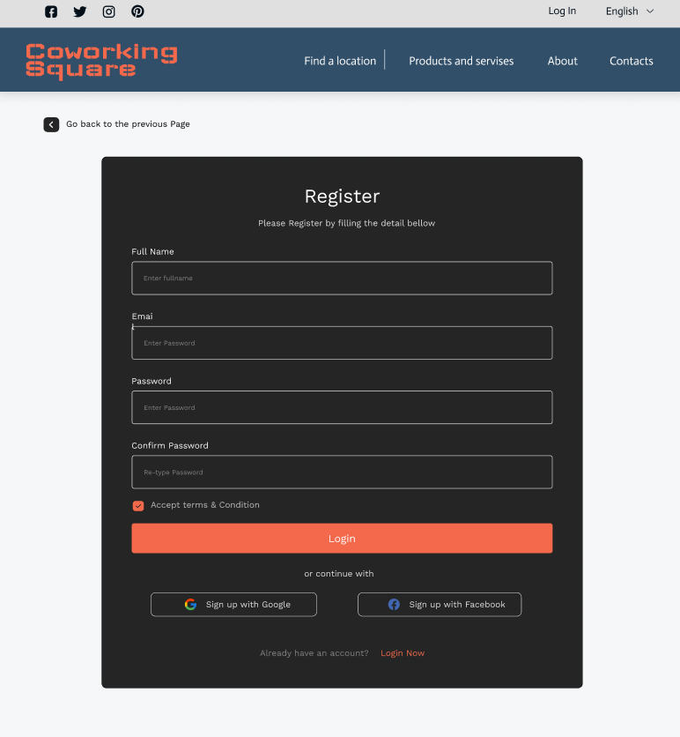

Slide 24
Thank you for your
attention

